Slide 1
Neural Machine Translation
Euskal Herriko Unibertsitatea (University of the Basque Country)
Multilingual, Character-Level, Non-parametric
Machine Translation
Kyunghyun Cho
Courant Institute of Mathematical Sciences (Computer Science) &
Center for Data Science,
New York University

Slide 2
A bit of historical remark
When did neural machine translation start, and where does it fit?

Slide 3
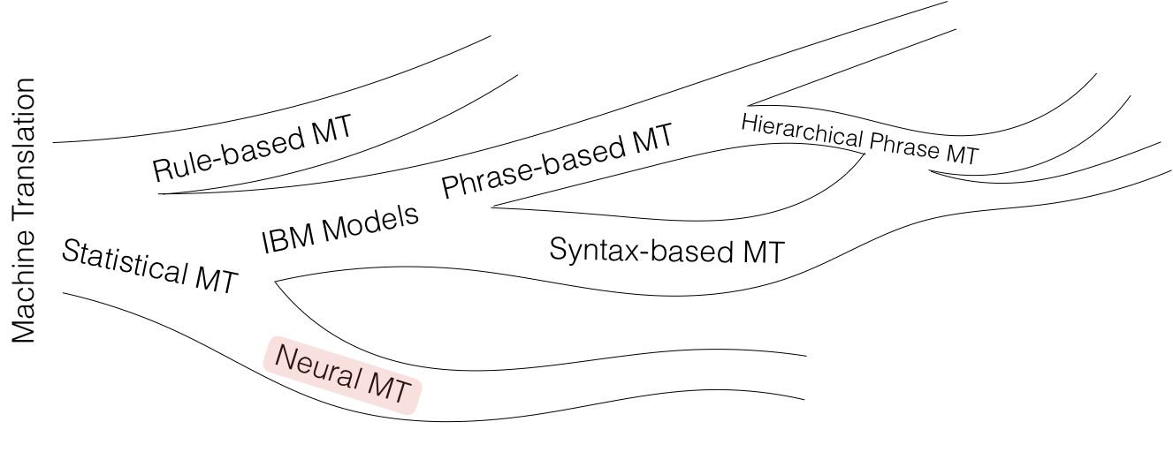

Slide 4
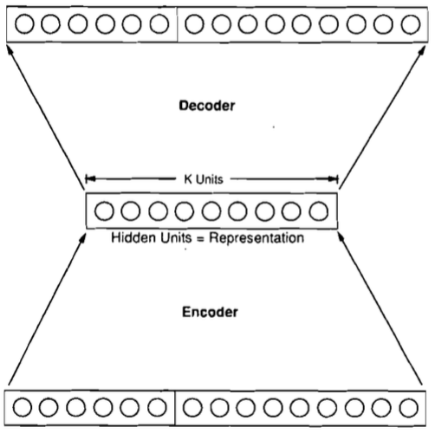
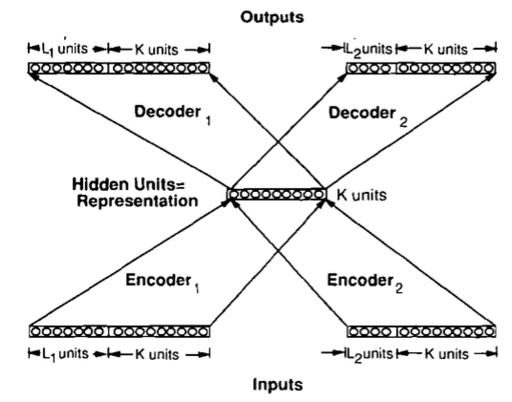
[Allen 1987 IEEE 1st ICNN]
3310 En-Es pairs constructed on 31 En, 40 Es words, max 10/11 word sentence; 33 used as test set
Binary encoding of words – 50 inputs, 66 outputs; 1 or 3 hidden 150-unit layers. Ave WER: 1.3 words
[Chrisman 1992 Connection Science]
Dual-ported RAAM architecture [Pollack 1990 Artificial Intelligence] applied to corpus of 216 parallel pairs of simple En-Es sentences:
Split 50/50 as train/test, 75% of sentences correctly translated!

Slide 5
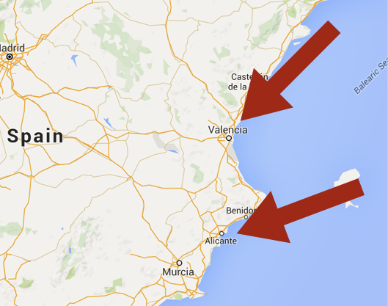
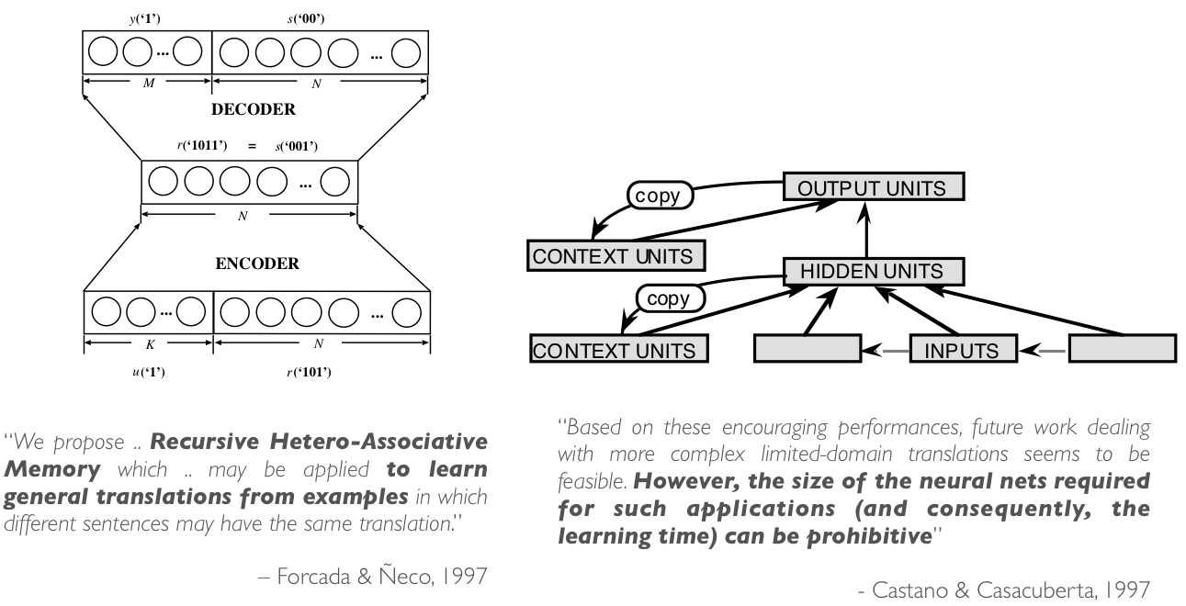
Brief resurrection in 1997: Spain

Slide 6
Modern neural machine translation

Slide 7
Machine Translation is Conditional Language Modelling
Language modelling, conditional language modelling to machine translation

Slide 8
Language modelling
A big question: how likely is a given sentence?
Sentence: a sequence of symbols
Language modelling:
But, what is it good for?

Slide 9
Conditional Language modelling (1)
A big question: how likely is a sentence given “context”?
Sentence: a sequence of symbols
Context: some variable
Conditional language modelling:
What can we do with it?
  Scoring:
  Generation

Slide 10
Conditional Language modelling (2)
Question-answering
  Context (Question): “Who is the President of the United States?”
  Candidate answers:
    “Obama is the President of the U.S.”
    “Tsipras is the President of America.”

Slide 11
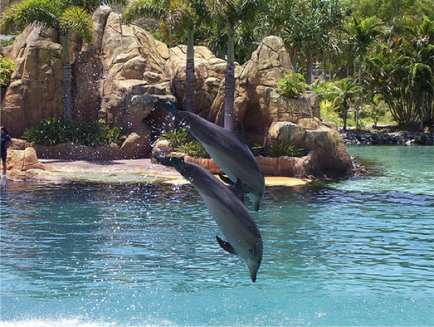
Conditional Language modelling (2)
Image caption generation
  Context (Image)
  Candidate answers:
    “Two dolphins are diving.”
    “Two men are flying.”

Slide 12
Recurrent language modelling (1)
Autoregressive modelling
Assumption: left-to-right generation (dependency)
Example:

Slide 13
Recurrent language modelling (2)
Autoregressive modelling
Model each conditional with a parametrized function approximator:
Generation process:

Slide 14
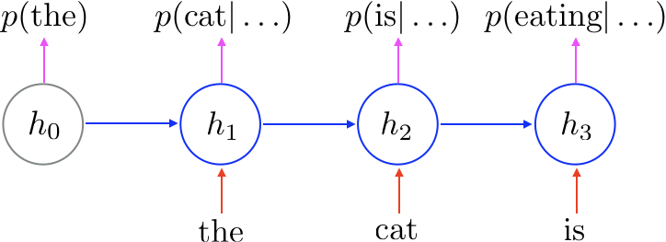
Recurrent language modelling (3)
Autoregressive modelling
(Mikolov et al., 2010; Graves, 2013)

Slide 15
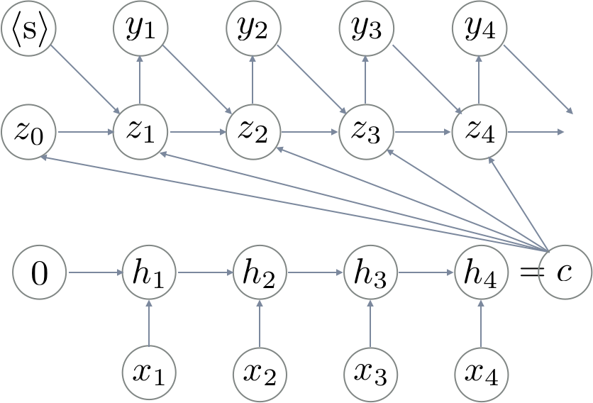
Neural machine translation
Conditional recurrent language model
Context: source sentence
  Compressed into a single vector
Language model: target sentence
Maximum likelihood learning
(Kalchbrenner & Blunsom, 2013; Sutskever et al., 2014; Cho et al., 2014)

Slide 16
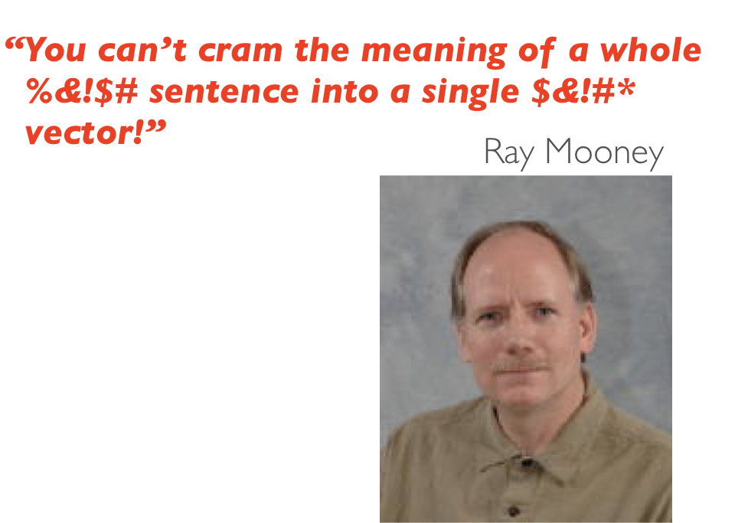
Attention-based neural machine translation (1)

Slide 17
Attention-based neural machine translation (2)
How human translators work…
Summarize what has been translated so far
Find a relevant part
Write the next target symbol
Go to 1

Slide 18
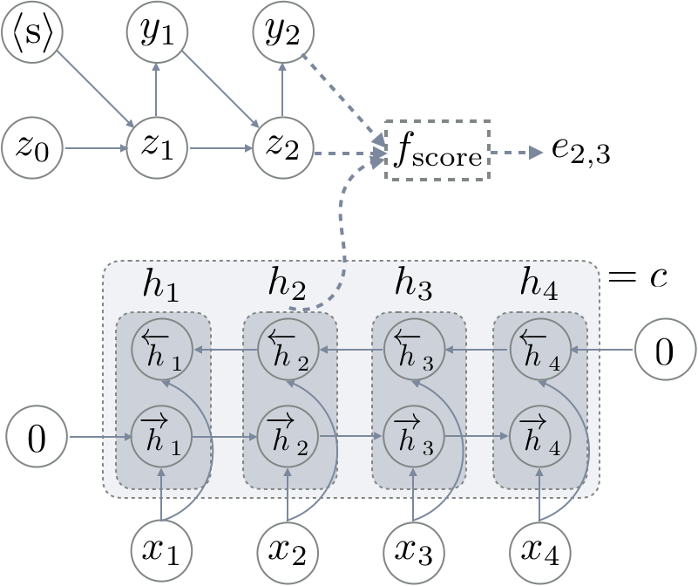
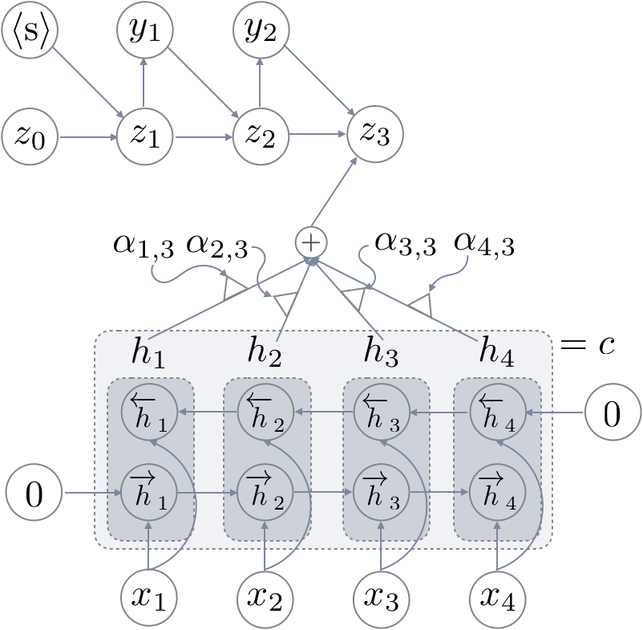
Attention-based neural machine translation (3)
Score each source symbol
Compute time-dependent context
(Bahdanau et al., 2015)

Slide 19
Attention-based neural machine translation (4)
(Bahdanau et al., 2015;
Jean et al., 2015)

Slide 20
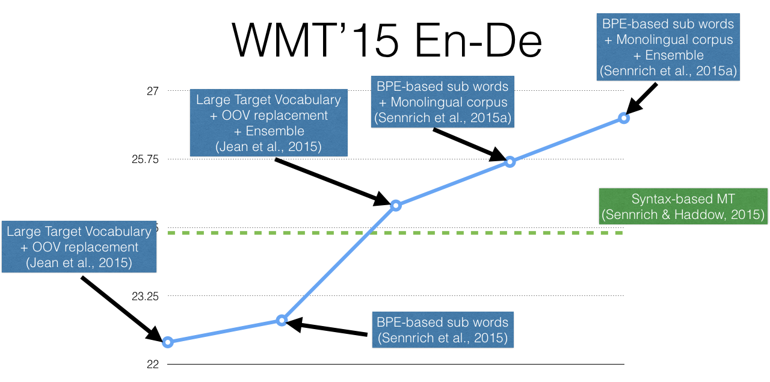
1 Year

Slide 21
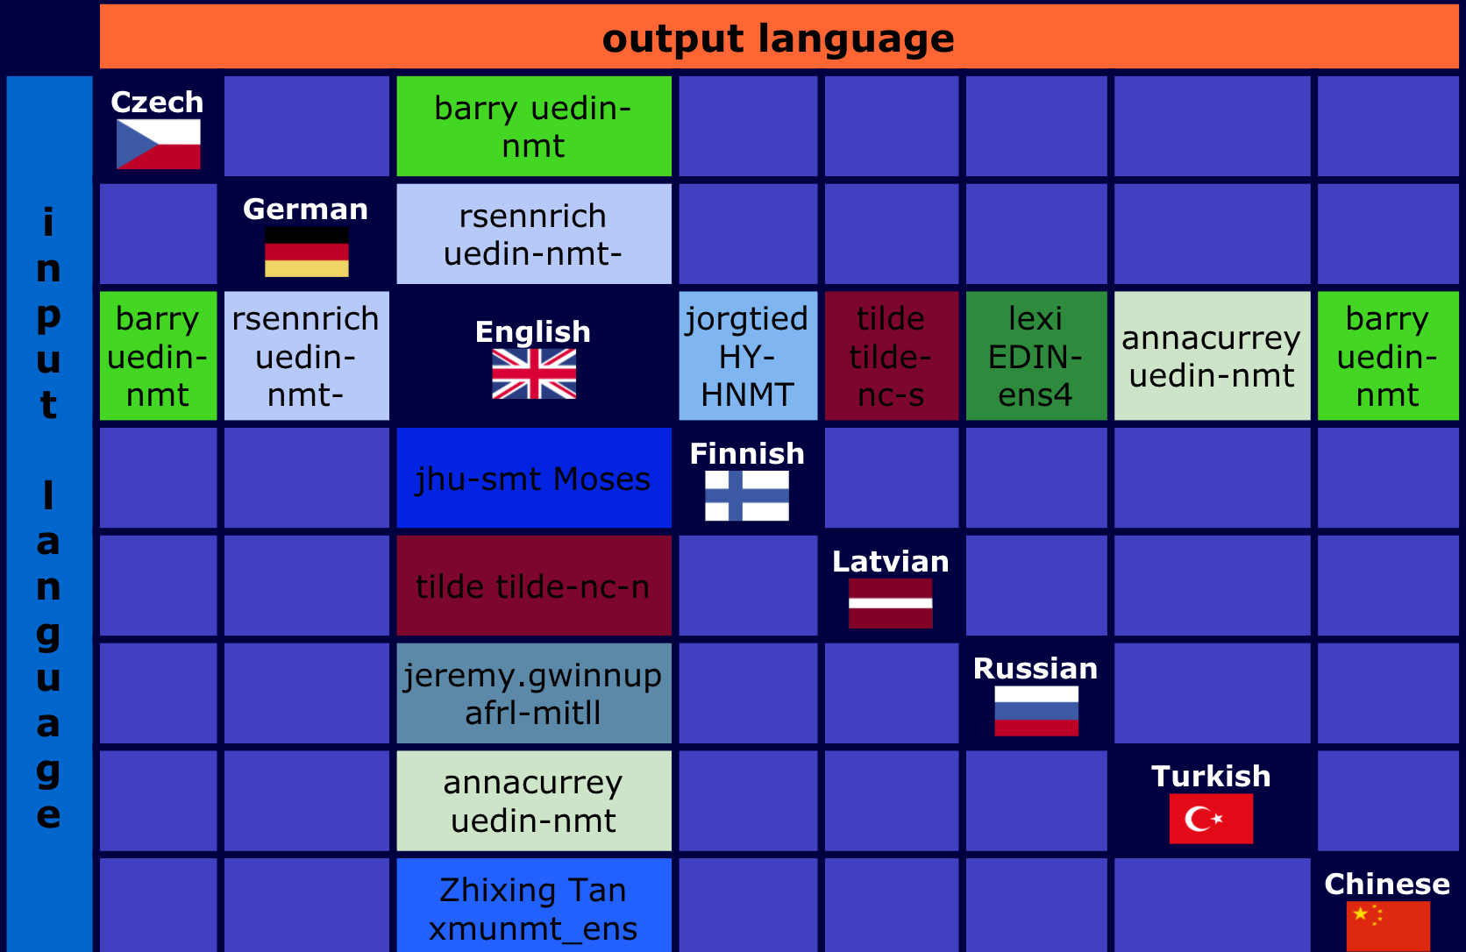
WMT 2017: news translation task

Slide 22
A better single-pair translation system has
never been “the” goal of neural MT

Slide 23
Continuous representation:
Interlingua 2.0?
What if we can project sentences in multiple languages into a single vector space?

Slide 24
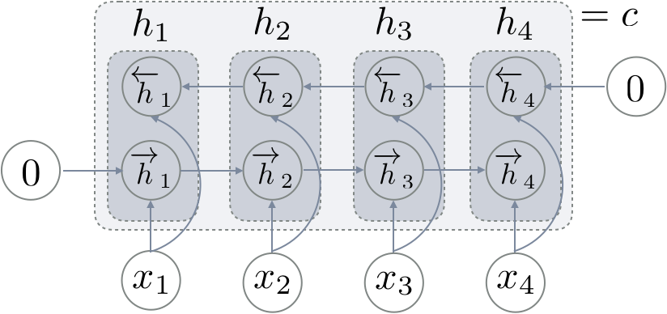
What does NMT do?
Encoder
Decoder+Attention
Project a source sentence into a set of continuous vectors
Decode a target sentence from a set of “source” continuous vectors

Slide 25
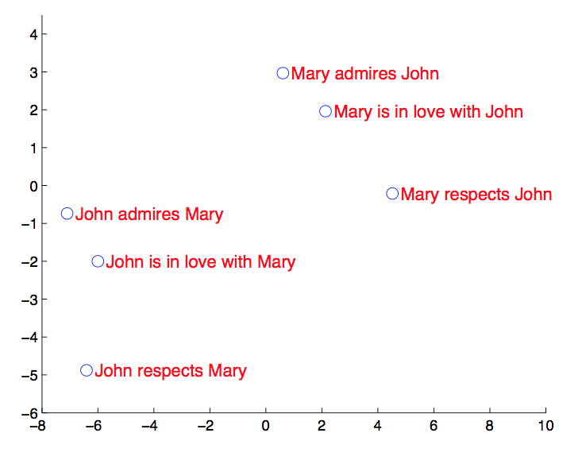
What is this “continuous vector space”?
Similar sentences are near each other in this vector space
Multiple dimensions of similarity are encoded simultaneously
(Sutskever et al., 2014)

Slide 26
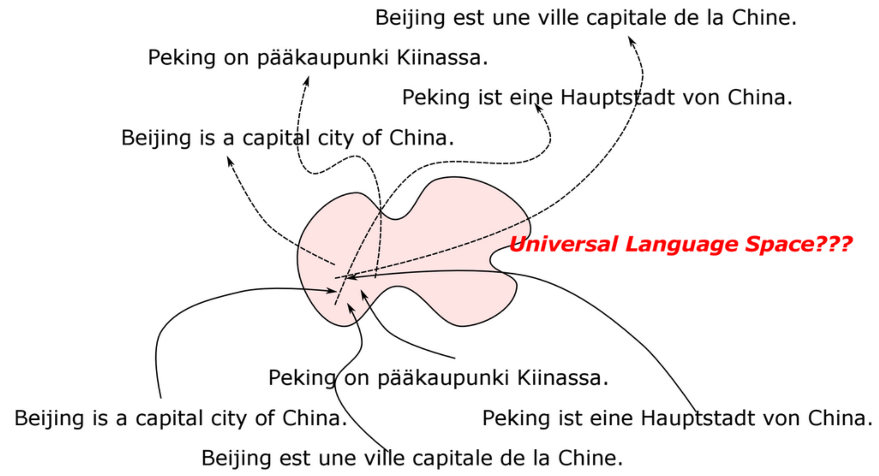
What is this “continuous vector space”?
Similar sentences are near each other in this vector space
Multiple dimensions of similarity are encoded simultaneously
(Trainable) near-bijective mapping between the continuous vector space and the sentence space
Stripped of hard linguistic symbols

Slide 27
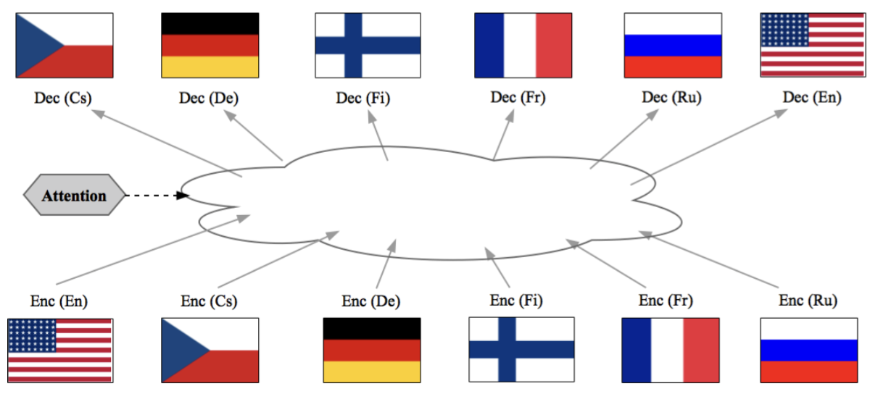
What is this “continuous vector space”?
Can this continuous vector space be shared across multiple languages?
(Firat et al., 2016; Luong et al., 2015; Dong et al., 2015)

Slide 28
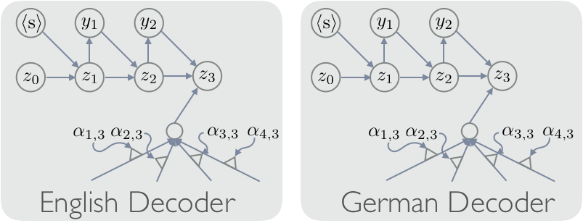
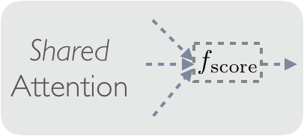
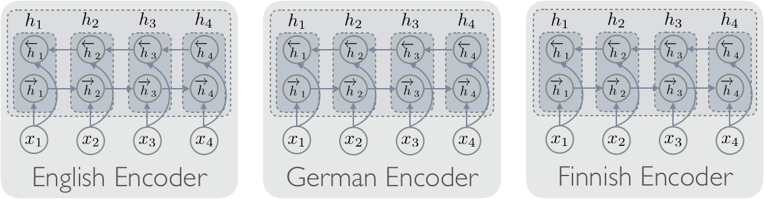
Multi-way, multilingual machine translation (1)
One encoder per source language
One decoder per target language
Attention/alignment shared across
all the language pairs
Only bilingual parallel
corpora necessary
  No multi-way parallel corpus needed
Language-agnostic
Continuous Vector Space
(Firat et al., 2016)

Slide 29
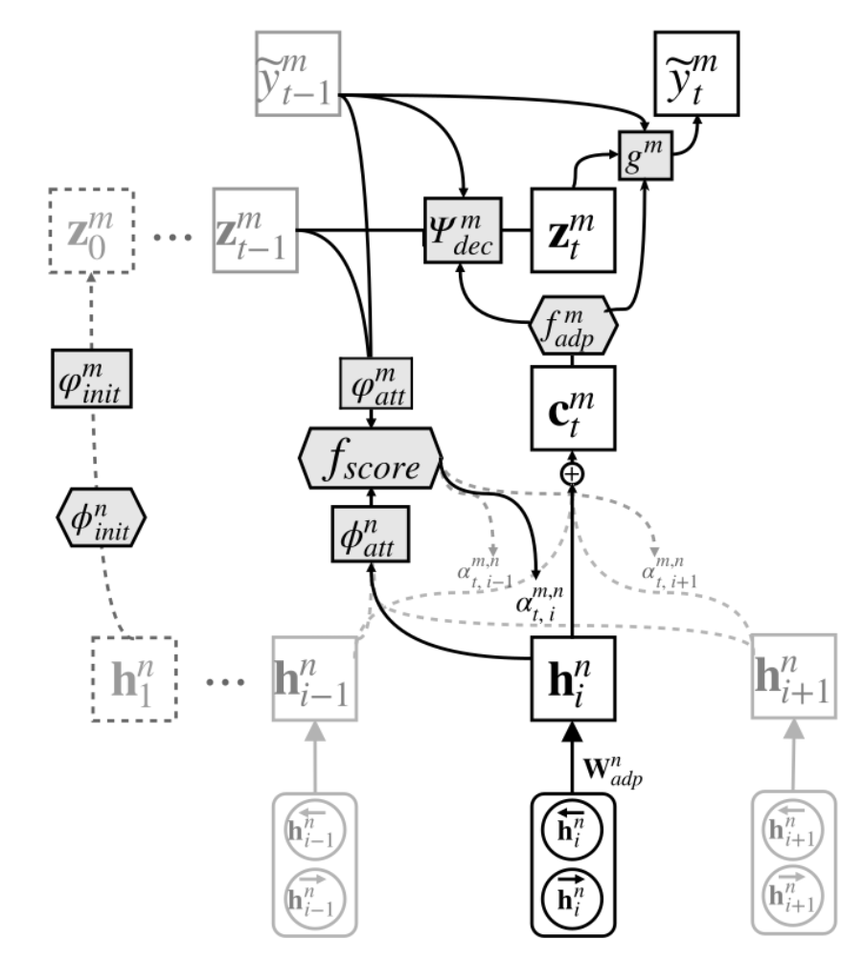
Multi-way, multilingual machine translation (2)
Neural nets are like lego
Build one encoder per source
Build one decoder per target
Build one attention mechanism
Given a sentence pair
(Firat et al., 2016)

Slide 30
Multi-way, multilingual machine translation (3)
Sentence-level positive language transfer
Helps low-resource language pairs
Why?
  Better structural constraint on the continuous vector space
  Regularization
Real-valued vector-based interlingua?
Language-agnostic
Continuous Vector Space
(Firat et al., 2016)

Slide 31
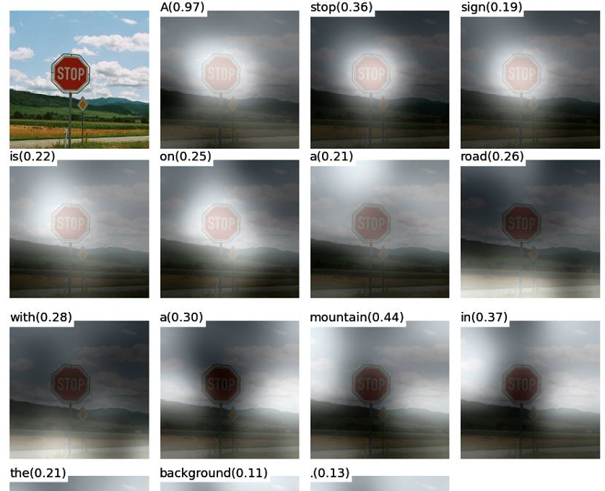
Beyond languages: multimodal translation
Does the source have to be “sentence”?
(Xu et al., 2015)

Slide 32
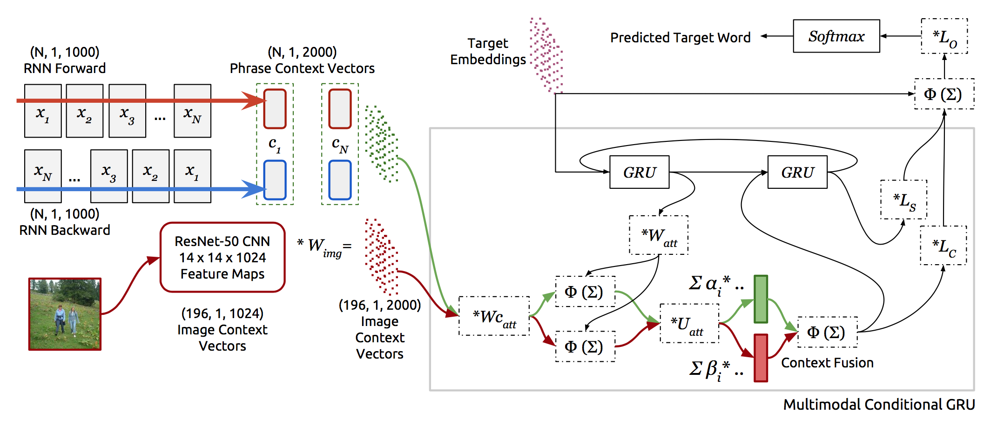
Beyond languages: multimodal translation
(Caglayan et al., 2016; Elliott & Kadar, 2017)

Slide 33
What is a sentence?
Is a sentence a sequence of phrases, words, morphemes or characters?

Slide 34
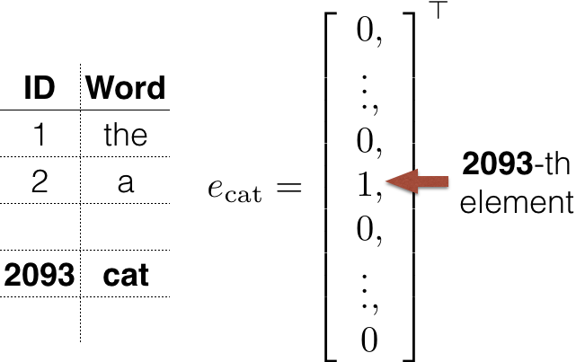
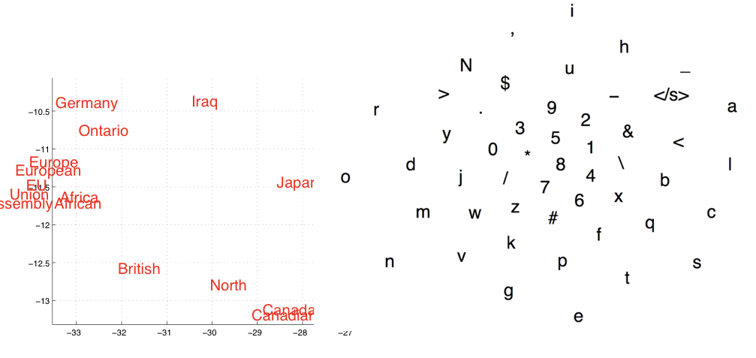
What is a sentence to a neural net?
Each word/symbol: one-hot vector
Prior-less encoding
Permutation invariant
Sentence
  To us: a sequence of words
  To NN: a sequence of one-hot vectors
What does it mean?

Slide 35

Why not words?
Inefficient handling of various morphological variants
  Sub-optimal segmentation/tokenization
  “Etxaberria”, “Etxazarra”, “Etxaguren”, “Etxarren”: four independent vectors
Lack of generalization to novel/rare morphological variants
  For instance, in Arabic => “and to his vehicle”
One vector for compound words?
  “kolmi/vaihe/kilo/watti/tunti/mittari” => one vector?
  “kolme” => one vector?
Spelling issues
  See Workshop on Processing Historical Language or Universal Dependencies
  Good segmentation/tokenization needed for each language
So, no, words don’t look like the units we want to work with…
Notes:
“Etxaberria”, “Etxazarra”, “Etxaguren”, “Etxarren”
New house, old house, the far side of the house, stone house

Slide 36
Then, what should we do…?
Original: Gothenburg is the second-largest city in Sweden
Word-level modelling:
(Gothenburg, is, the, second, -, largest, city, in, Sweden)
Subword-level modelling (Sennrich et al., 2015; Wu et al., 2016)
(Gothen, burg, is, the, seco, nd, -, larg, est, city, in, Sweden)
Character-level modelling with segmentation
(Wang et al., 2015; Luong & Manning, 2016; Costa-Jussa & Fonollosa, 2016)
((G,o,t,h,e,n,b,u,r,g), (i,s), (t,h,e), (s,e,c,o,n,d), (-), (l,a,r,g,e,s,t), (c,i,t,y), (i,n), (S,w,e,d,e,n))
Fully character-level modelling (Chung et al., 2016; Lee et al., 2017)
(G,o,t,h,e,n,b,u,r,g, ,i,s, ,t,h,e, ,s,e,c,o,n,d,-,l,a,r,g,e,s,t, ,c,i,t,y, ,i,n, ,S,w,e,d,e,n)

Slide 37
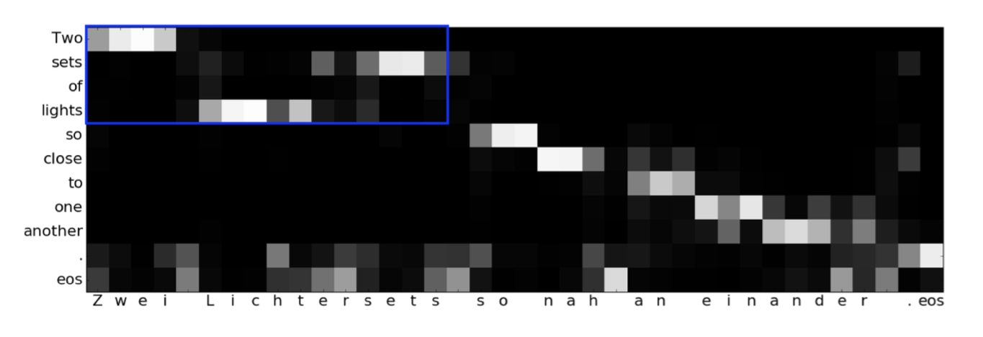
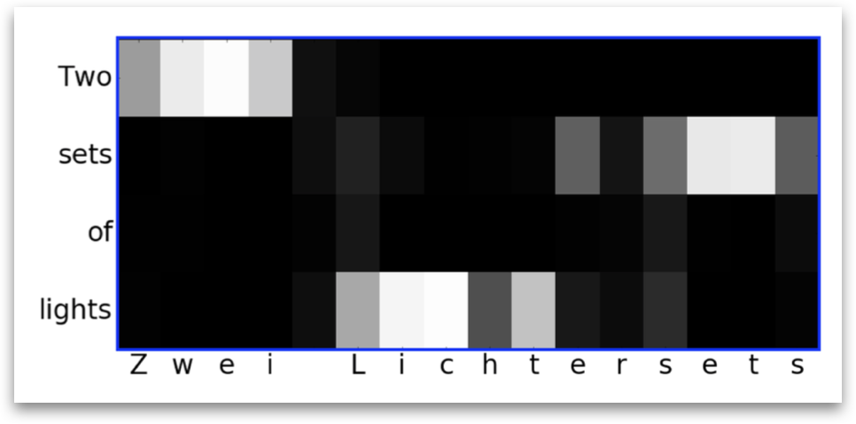
Character-level translation
Source: subword-level representation
Target: character-level representation
The decoder implicitly learned word-like units automatically!
(Chung et al., 2017)

Slide 38
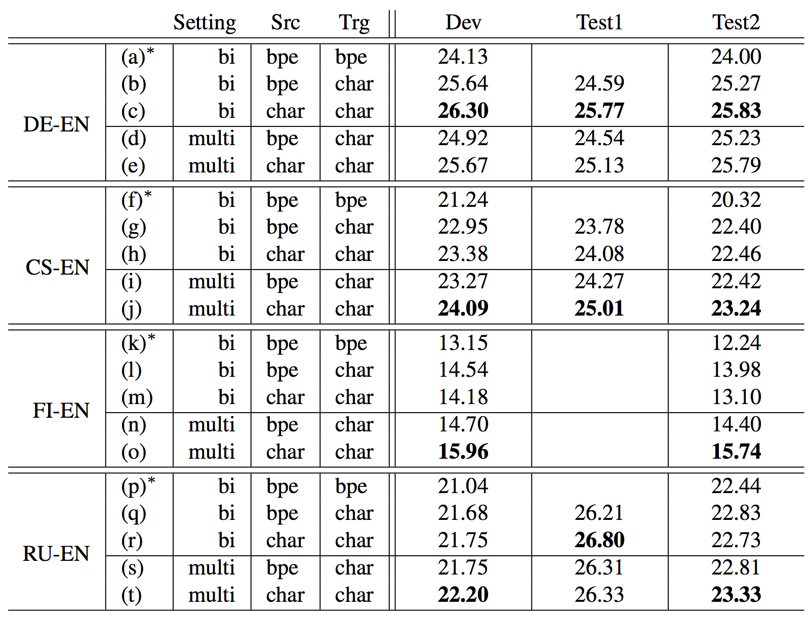
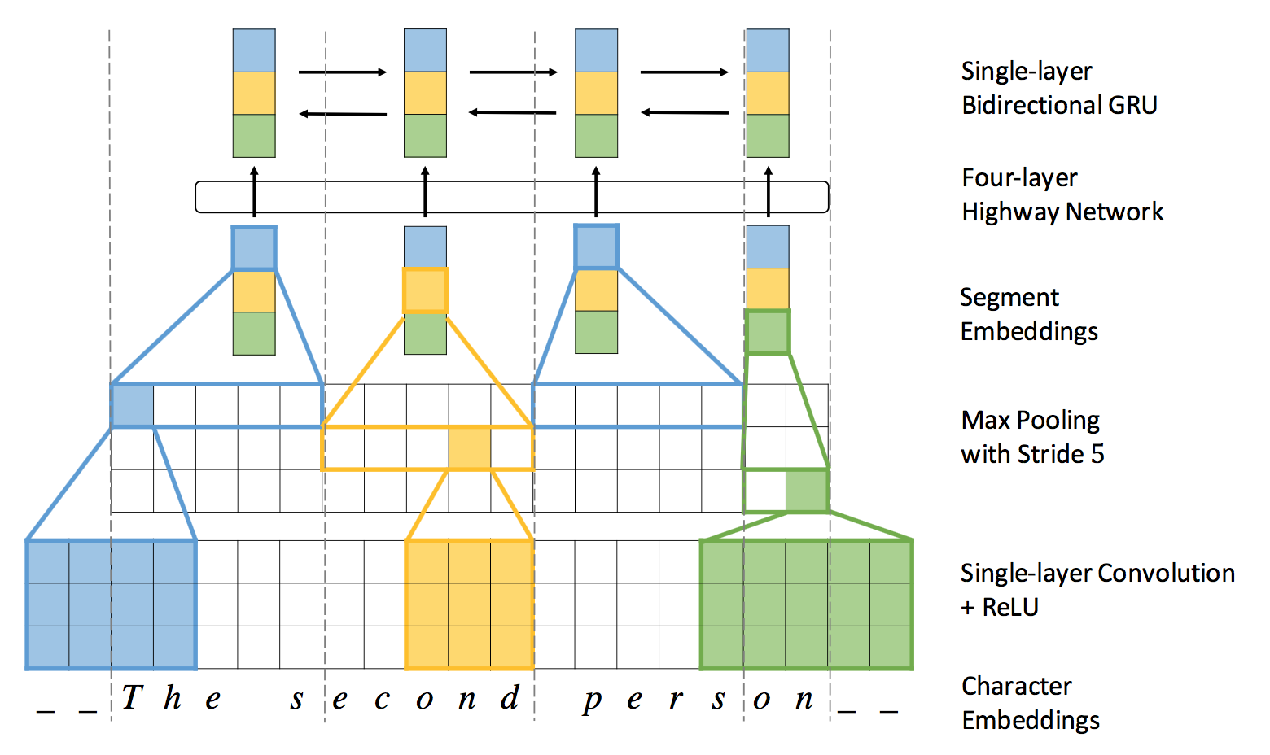
Fully Character-level translation
(Lee et al., 2017)
Source: character-level representation
Target: character-level representation
Efficient modelling with
a convolutional-recurrent encoder
Works as well as, or better than,
subword-level translation

Slide 39
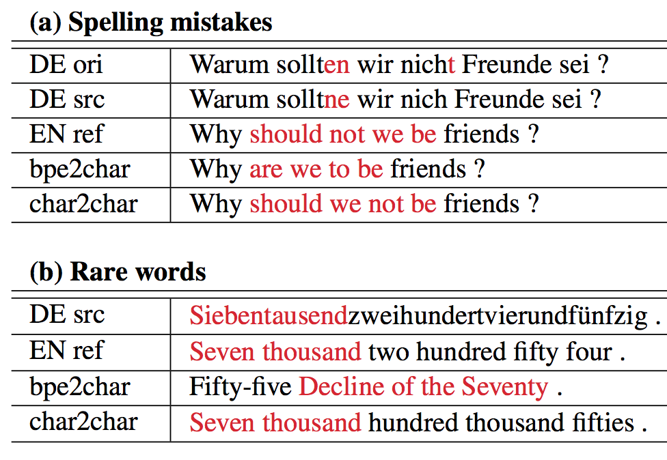
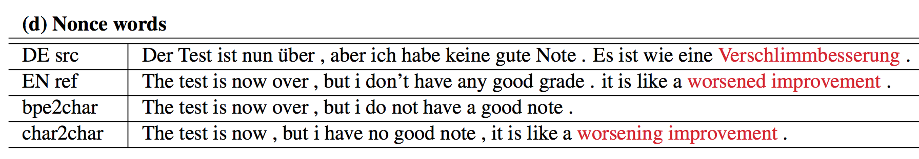
More robust to errors
Better handles rare tokens
  Rare tokens are not necessary rare!
(Lee et al., 2017)

Slide 40
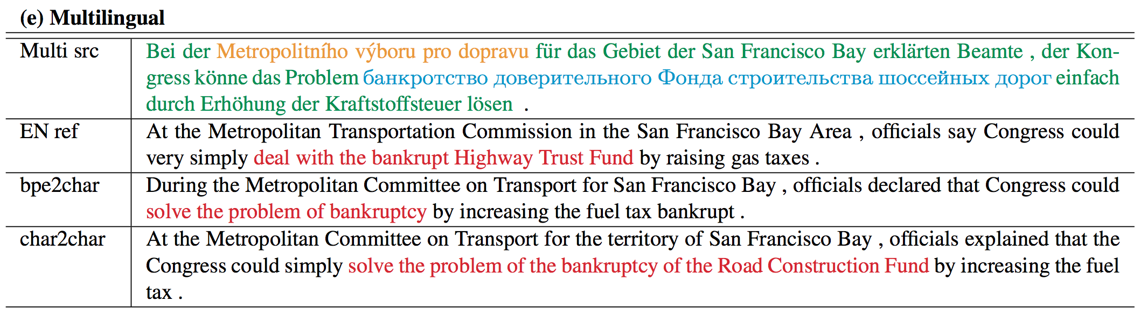
Character-level Multilingual Translation
When symbols are shared across multiple languages, why not share a single encoder/decoder for them?
  Language transfer at all levels: letters, words, phrases, sentences, …
  Intra-sentence code-switching without any specific data
(Lee et al., 2017; Johnson et al., 2016; Ha et al., 2016)

Slide 41
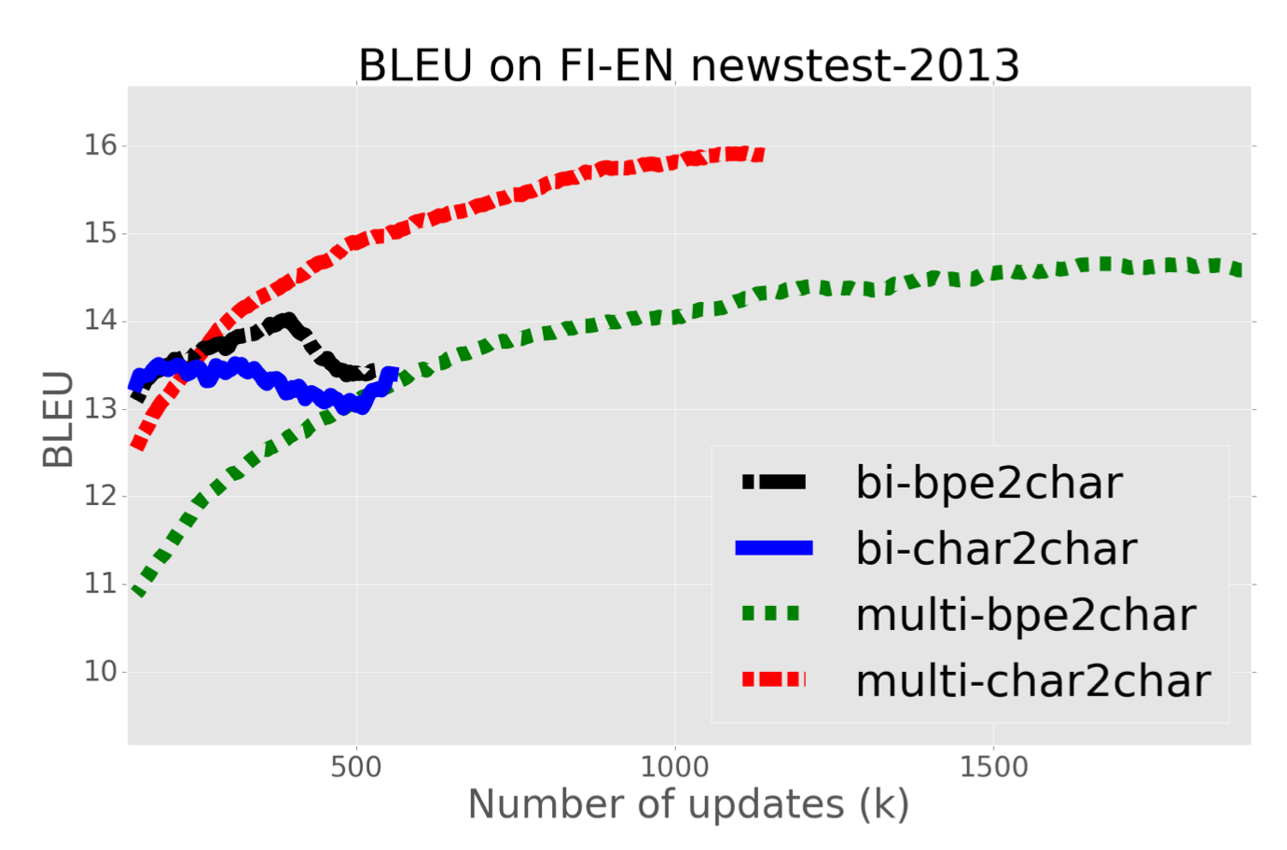
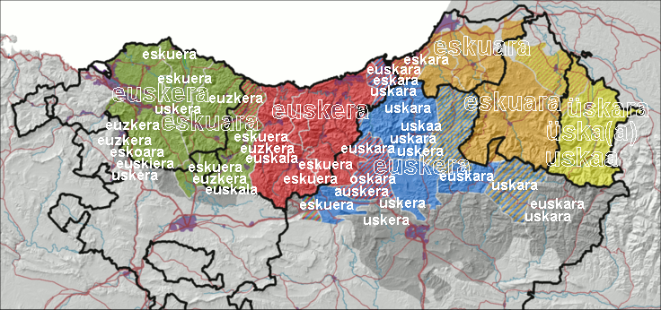
Character-level Multilingual Translation
Prevents overfitting with low-resource language pairs
Perhaps, a way to build a MT
system for Basque languages?
  Many dialects: Biscayan,
  Gipuzkoan, Navarrese,
  Navarro-Lapurdian, Souletin
(Lee et al., 2017)

Slide 42
Non-parametric neural machine translation
Bridging question-answering, information retrieval and machine translation

Slide 43
A general question-answering machine
Natural language query understanding
Information retrieval
Information fusion
Answer synthesis

Slide 44
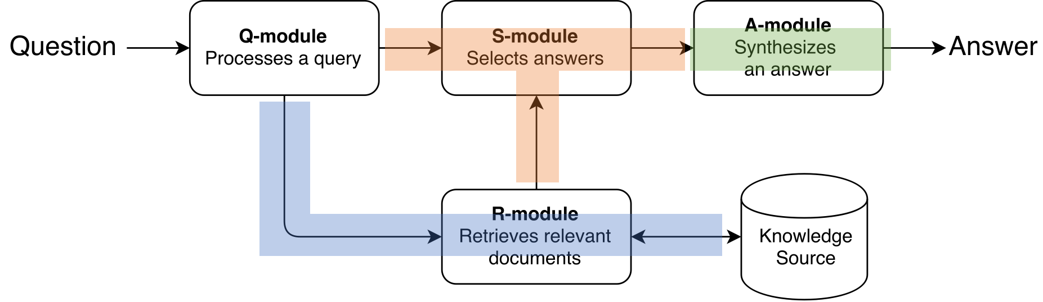
Neural Query Reformulator
Neural Query Reformulator
Reads an original query q0
Augment/reformulate q0
Learning
Hard RL problem: partial observability due to the black box search engine
Policy gradient to maximize recall@K
(Nogueira & Cho, 2017; Buck et al., 2017)
Code and data available at https://github.com/nyu-dl/QueryReformulator

Slide 45
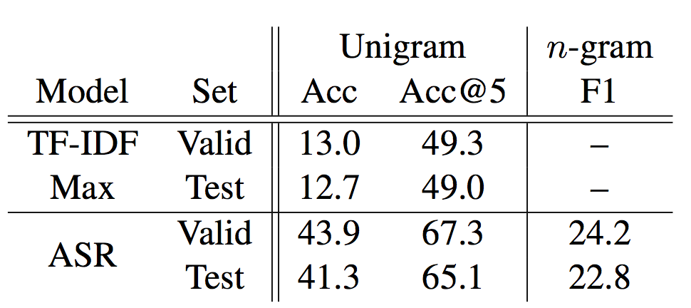
SearchQA: new dataset for machine comprehension
SearchQA
Realistic, noisy context from Google
Multiple snippets per question
Large-scale data (140k q-a-c tuples)
(Dunn et al., 2017; Buck et al., 2017)
Data available at https://github.com/nyu-dl/SearchQA

Slide 46
Underlying ideas
Exploits an off-the-shelf, black-box search engine
  Fast retrieval of relevant information from a vast amount of sources
Retrieved information is inherently noisy
  Search engines are never perfect
  A search engine maximizes its own internal (unknown) reward
Neural networks “adapt” to such a black-box search engine
  Neural networks must “learn” to use a black-box component
Can neural machine translation use a search engine as well?

Slide 47
Retrieval Stage
Off-the-shelf search engine indexes the whole training set
The engine is queried with a current source sentence
Only top-few translation pairs are selected at the end
Extremely efficient!
(Gu et al., 2017)

Slide 48
Translation Stage (1)
Store the retrieved pair in a key-value memory (Gulcehre et al., 2016; Henaff et al., 2017)
Use the attention-based neural machine translation
  Key: the context vector
  Value: the target symbol
(Gu et al., 2017)

Slide 49
Translation Stage (2)
Retrieves relevant target symbols from the memory
  Key: the current context vector
Incorporate the retrieved value into computing the target distribution
(Gu et al., 2017)

Slide 50
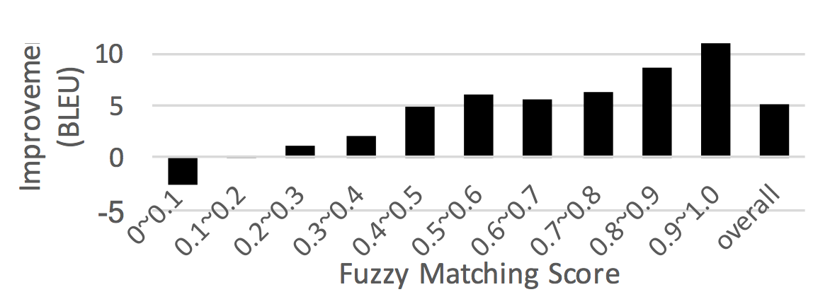
Better retrieval, better translation

Slide 51
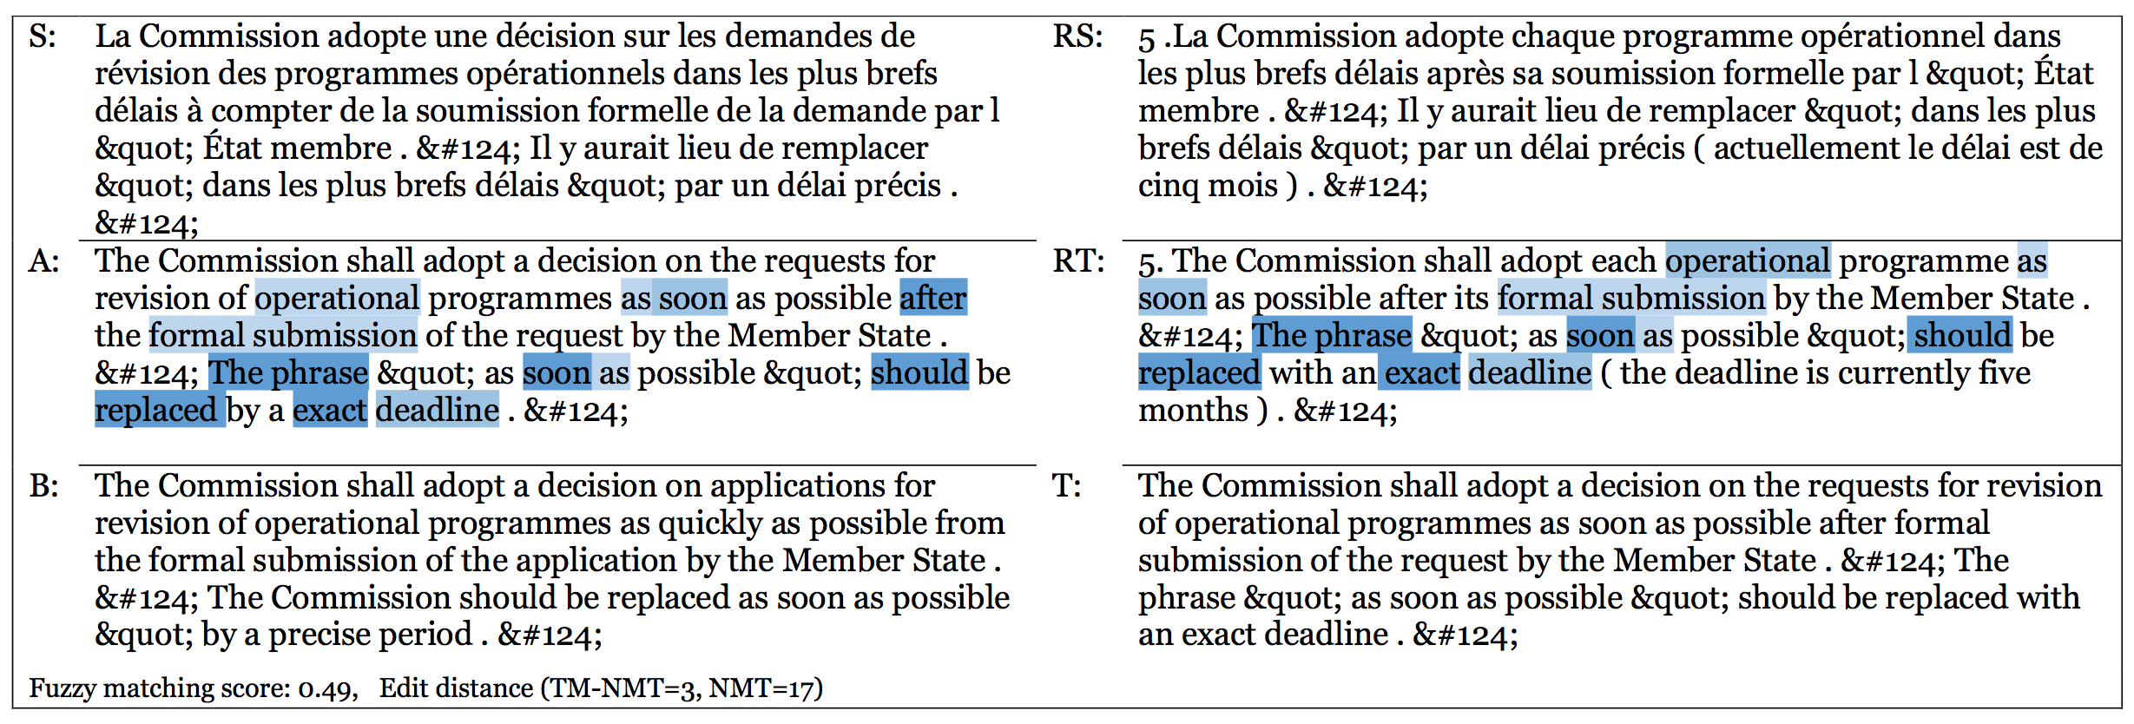
More consistent translation
Translation with consistent style and word choice
Personalized translation

Slide 52
Other advances in neural machine translation
Discourse-level machine translation
  [Jean et al., 2017; DCU, 2017]
Better decoding strategies
  Learning-to-search [Wiseman & Rush, 2016]
  Reinforcement learning [MRT, 2016; Ranzato et al., 2015; Bahdanau et al., 2015]
  Trainable decoding [Gu et al., 2017]
  Alternative decoding cost [Li et al., 2016; Li et al., 2017]
Linguistics-guided neural machine translation
  Learning to parse and translate [Eriguchi et al., 2017; Rohee & Goldberg, 2017; Luong et al., 2016]
  Syntax-aware neural machine translation [Nadejde et al., 2017]

Slide 53
Task-driven Linguistics
Understanding what neural networks have learned about languages

Slide 54
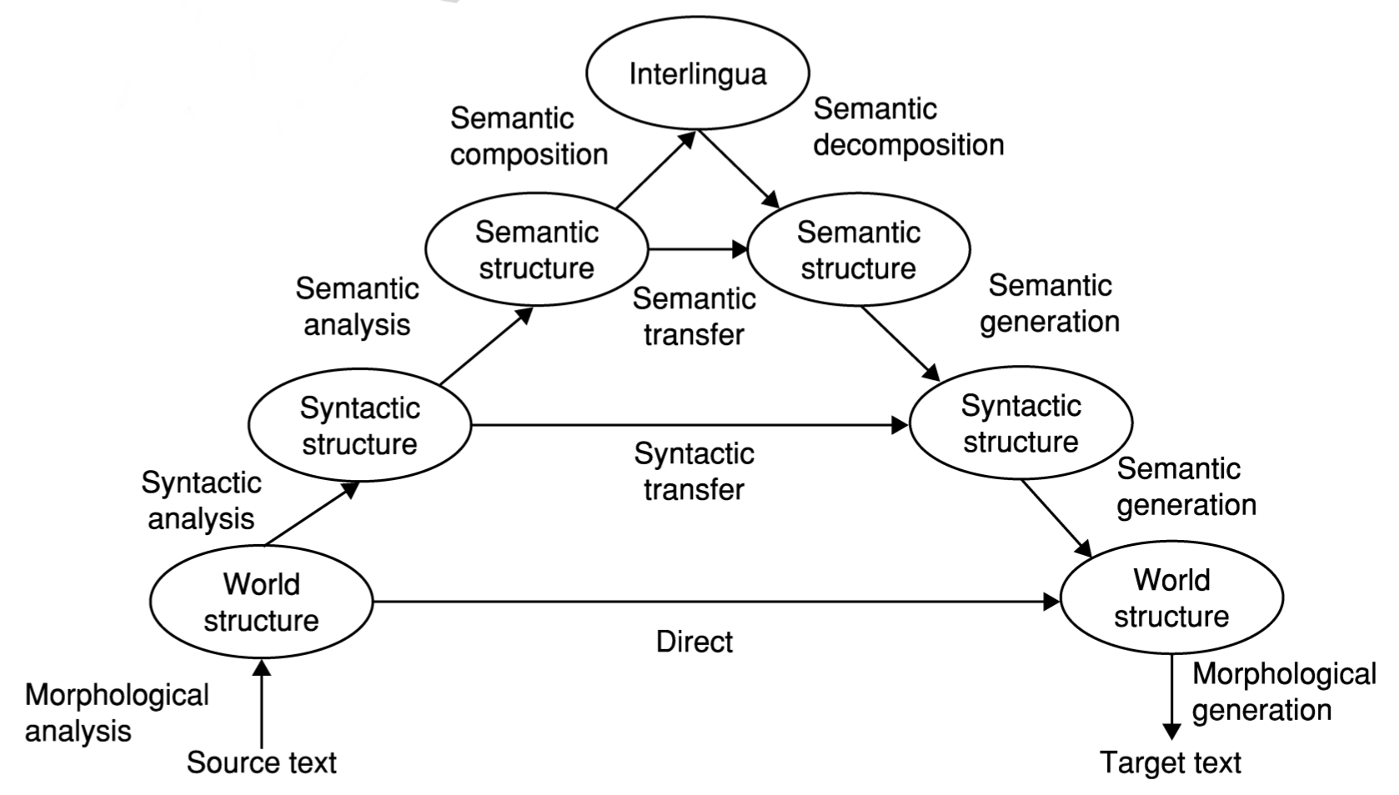
Task-driven Linguistics (1)
?
What has the neural net learned about natural languages?
Can it tell us one or two things about language that we didn’t know?

Slide 55
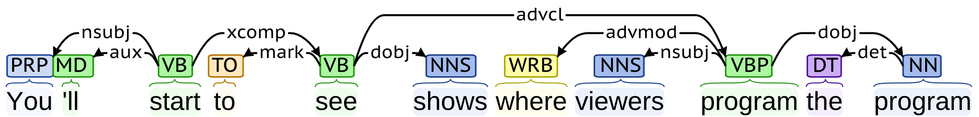
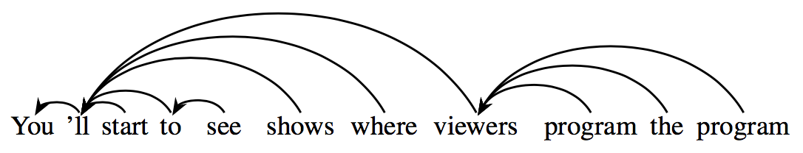
Task-driven Linguistics (2)
Dependency parser (Stanford parser)
Unsupervised recurrent language model (Lee, Levy & Zettlemoyer, 2017)

Slide 56
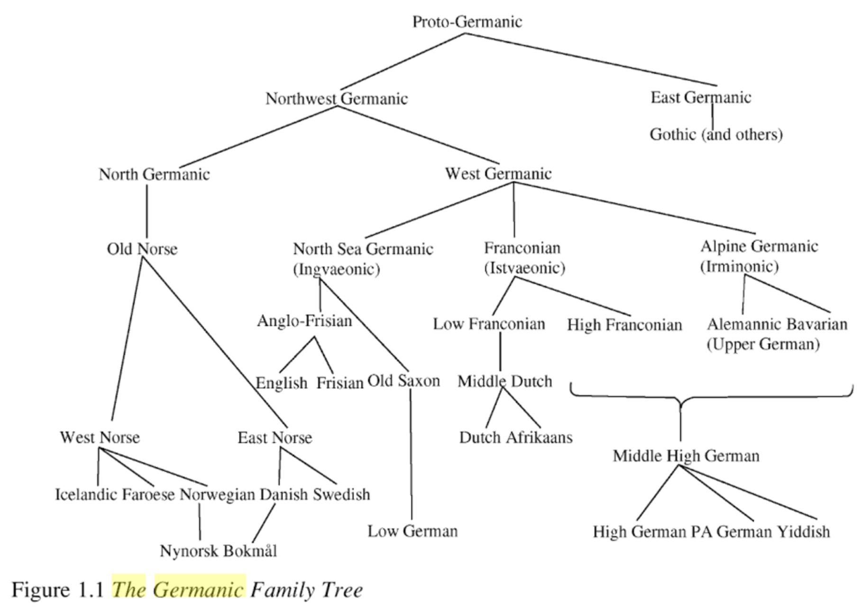
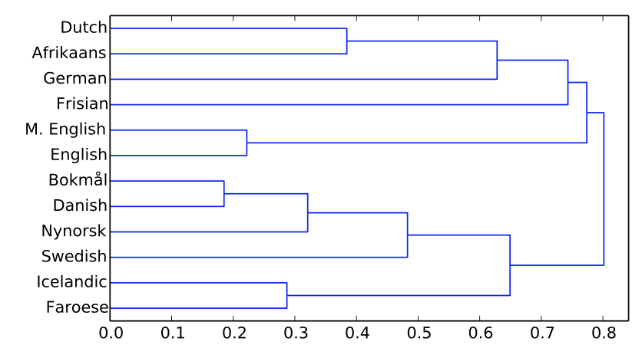
Task-driven Linguistics (3)
The Germanic Languages (Harbert, 2006)
Multilingual recurrent language model
(Östling & Tiedemann, 2016)

Slide 57
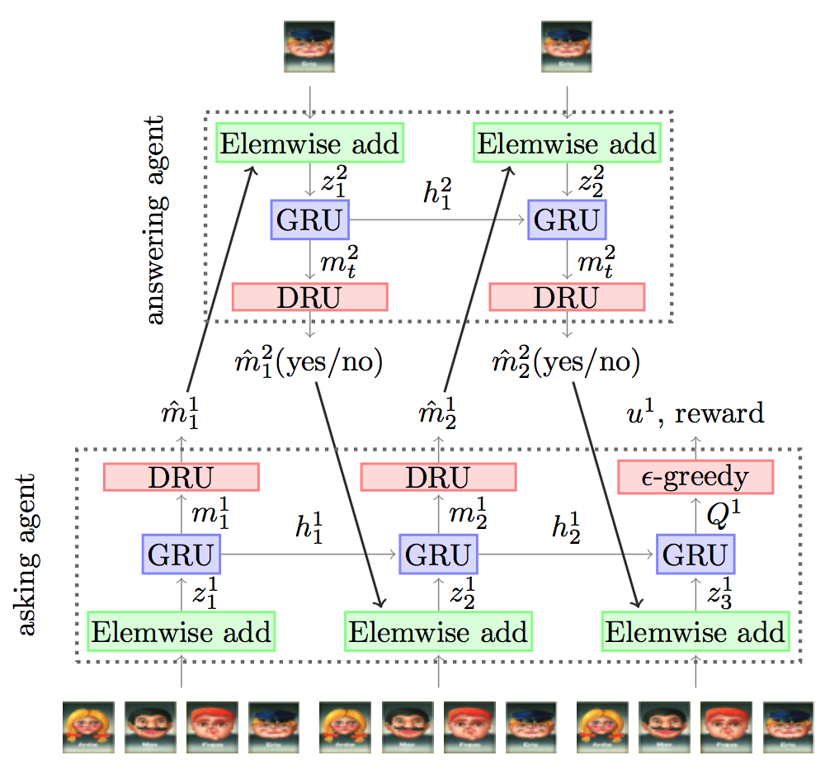
Task-driven Linguistics (4)
Pragmatics and Grounding
Communicating neural networks
(Lazaridou et al., 2017; Jorge et al., 2017; Evtimova et al., under review; and others)

Slide 58
Task-driven Linguistics – Proposal
Build/update a end-to-end trainable system for a task
Train the system for the task using (large) data
Analyze the trained system with respect to known facts/properties
Extract new knowledge out of the trained system.
Go back to 1
Eskerrik asko!

